Slide 1

IBM Business Automation Manager Open Editions Open Source, Cloud-Native Business Automation
Technical Seller Enablement

Slide 2
Local Machine Setup
Making sure Java is configured…..
Is the JDK 17 installed?
Open a terminal window and type the command “java –version”, which should be in your PATH and should return a result such as the version, JAVA_HOME location etc.

Slide 3
Local Machine Setup
Making sure GIT is configured…..
Is the GIT CLI installed?
Open a terminal window and type the command “git –version”, which should be in your PATH and should return a result such as the version, etc.

Slide 4
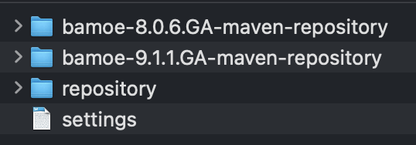
Local Machine Setup
Is the Maven CLI installed?
Open a terminal window and type the command “mvn –version”, which should be in your PATH and should return a result such as the version, MAVEN_HOME location etc.
Got to the location where you cloned the bamoe-setup repository and perform the following command: git pull, which will ensure that you have the latest changes from the repository.
Locate your .m2 folder, which should be located in your user directory and could be “hidden” by your operating system.
Copy the folder named “bamoe-9.1.1.GA-maven-repository” from the bamoe-setup/maven folder to your .m2 directory. This serves as your “offline” version of the BAMOE libraries in the event that you have no other access to BAMOE libraries.
Copy the file named “settings.xml” from the bamoe-setup/maven folder to your .m2 directory. There may already be a “settings.xml” in the .m2 folder, so either save this as a backup copy or feel free to overwrite it.
Go to the location where you cloned the card-approval-process repository and perform the following command: mvn clean install, which will build the project using the correct Maven configuration.
Making sure Maven is configured…..
$USER/.m2 folder

Slide 5



Local Machine Setup
Making sure VS Code & BAMOE Dev Tools is configured…..
Is the VS Code IDE installed?
Are the BAMOE Dev Tools installed?
Is the Drools community editor installed?

Slide 6
IBM Business Automation Manager Open Editions
Decision Automation in Practice

Slide 7
IBM Business Automation Manager Open Editions
Day 1 - Open Discussion + Q&A

